Slide 1
Predictive Index – Overview & Support Slides

Slide 2
Expected Outcomes from the PI:
Improved Hiring Decisions
Improved On-Boarding
Increase Speed of Success
Improved Self-Awareness
Collection of People Data
Improved Employee Development
Improved Team Performance & Execution of Goals
Diversity of Thought
Understanding of Organizational Culture

Slide 3
Dominance
The drive to exert one’s influence on people or events
A
Extraversion
The drive for social interaction with others
THE PREDICTIVE INDEX (PI)
Drives Measured by the PI
B
Patience
The drive for consistency and stability
C
Formality
The drive to conform to rules and structure
D

Slide 4
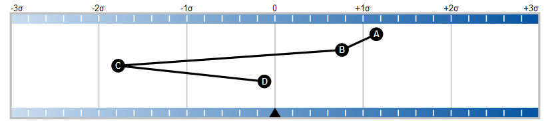
Reading a PI Pattern
Situational
Predictable
Predictable
Very
Predictable
Very
Predictable
Lower
0= Balanced Norm
Higher

Slide 5
Dominance
A
Drive: The drive to exert one’s influence on people or events
LOW
HIGH
Need | Behavior
Encouragement & reassurance Harmony Strong leadership Supportive, team-oriented environment Freedom from competition | Cooperative Accommodating Harmony-seeking Collaborative Promotes collective efforts
Need | Behavior
Independence Control of activities Autonomy in problem solving Opportunities to compete and take the lead | Independent Challenges the status quo Comfortable with conflict Autonomous Deals with adversity

Slide 6
Extraversion
B
Drive: The drive for social interaction with others
LOW
HIGH
Need | Behavior
Opportunity for introspection Time to trust others Freedom from office “Politics” Private/personal recognition | Introspective Reflective Analytical Thinks before acting Straight-forward
Need | Behavior
Opportunities to work with others Social acceptance Prestige and status Visible signs of recognition | Outgoing People-oriented Sociable Engaging

Slide 7
Patience
C
Drive: The drive for consistency and stability
LOW
HIGH
Need | Behavior
Variety and change of pace Mobility Freedom from repetition Work where results are achieved quickly | Driving Fast-paced Quick to act Intense Multi-tasking
Need | Behavior
Ability to work at a steady pace Stable work environment Familiar surroundings/people Supportive “family-like” team | Consistent Approachable Handles routines Attentive listener

Slide 8
Formality
D
Drive: The drive to conform to rules and structure
LOW
HIGH
Need | Behavior
Freedom from rigid structure or tight rules and controls Opportunity to delegate details Informality Freedom of expression | Informal Flexible Spontaneous Non-conforming Tolerant of uncertainty
Need | Behavior
Clarity of expectations/rules Structure and clear definition of responsibility Freedom from risk of error | Diligent Thorough Process/system driven Precise Cautious

Slide 9
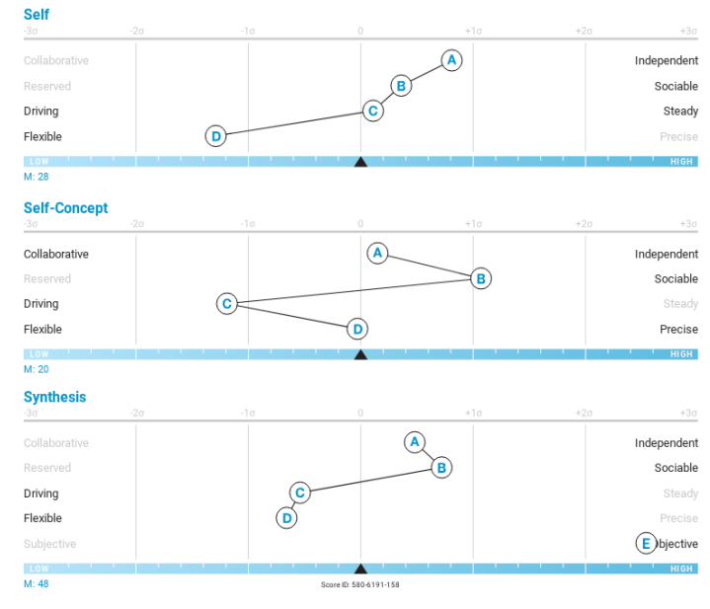
It Starts with Understanding Your “Selves”
Self Instinctive attitudes and behaviors– what comes naturally – difficult to change
Self-concept Perception of what the job environment currently demands – changeable
Synthesis Behaviors people experience and observe when working with you

Slide 10
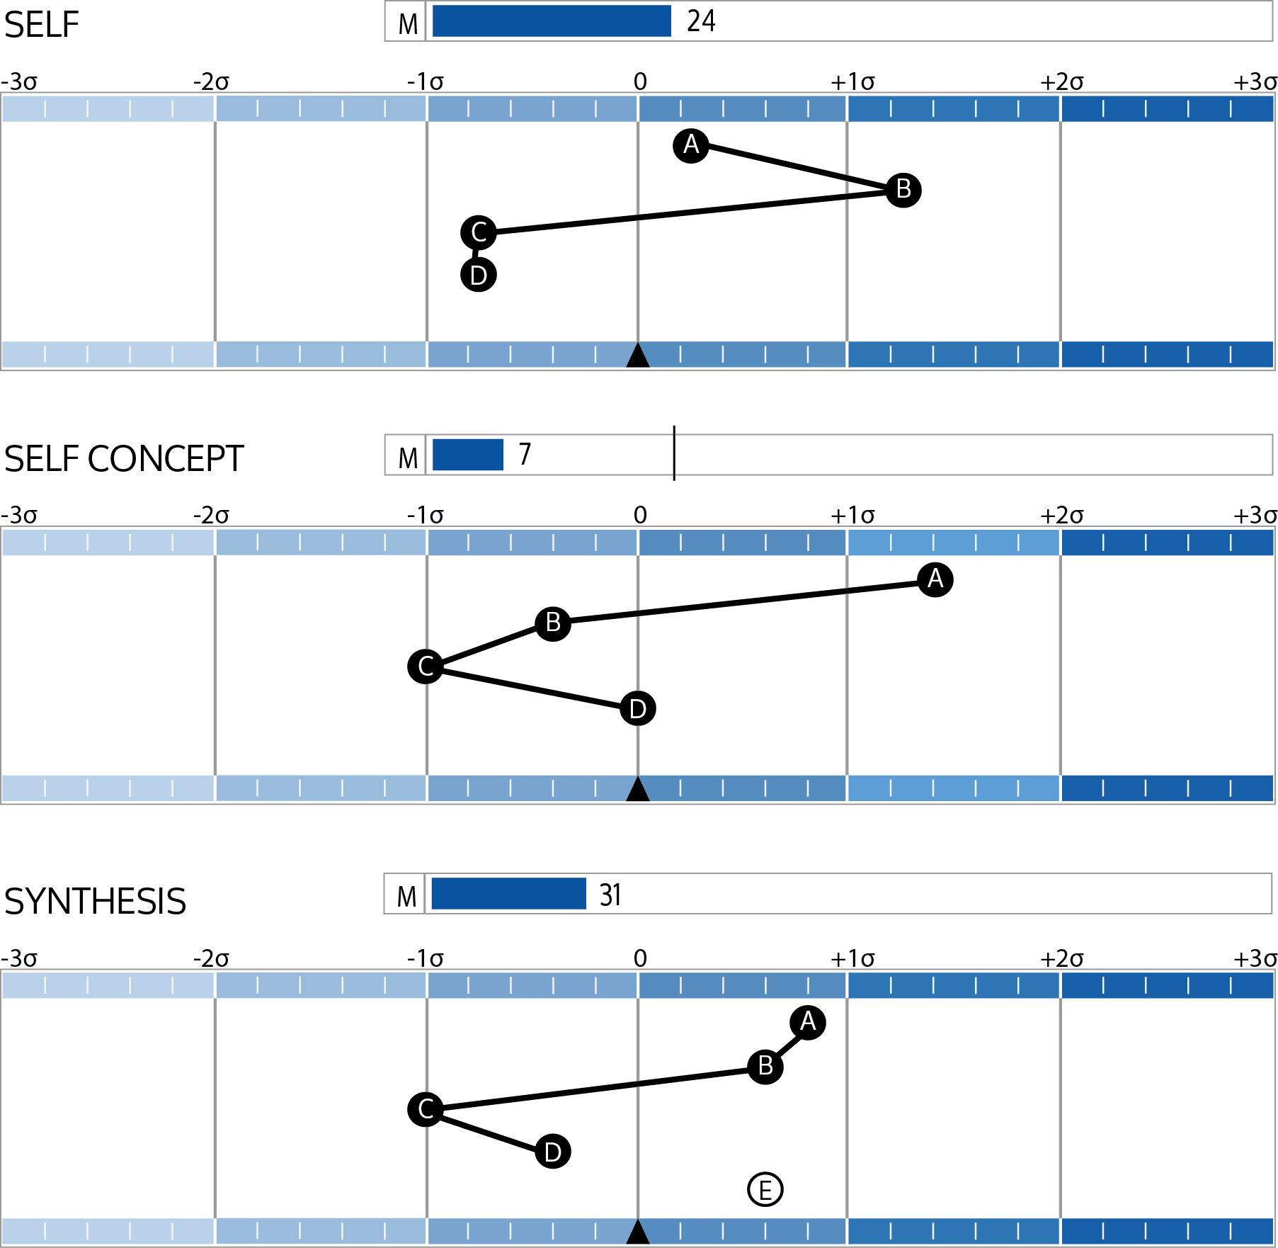
Factor E
Reflects our decision making or judgment style
subjective
objective

Slide 11
When Behaviors Are Ineffective…
 | Low (Less than average) | High (Greater than average)
Dominance | Avoids friction Reluctant to offer views Risk sensitive Timid | Dominates Threatening Intolerant of other views Pursues their own agenda
Extraversion | Blunt Emotionally disconnected Hard to get to know Little disclosure / little feedback | Not to the point Image conscious Unrealistic Action vs. results
Patience | Underestimates time Fires before aiming Creates tension Loses focus if it can’t be finished quickly | Slower to adapt Resistant to change Has difficulty setting priorities Reactive
Formality | Rebellious of authority Lacks focus Lacks self-discipline Doesn’t tie ends together | Avoids risk Inflexible Demanding Absorbed in details

Slide 12
PI Reference profiles
Analytical
Social
Stabilizing
Persistent
Analyzer
Controller
Altruist
Captain
Adapter
Craftsman
Individualist
Specialist
Strategist
Collaborator
Maverick
Guardian
Operator
Scholar
Venturer
Persuader
Promoter

Slide 13
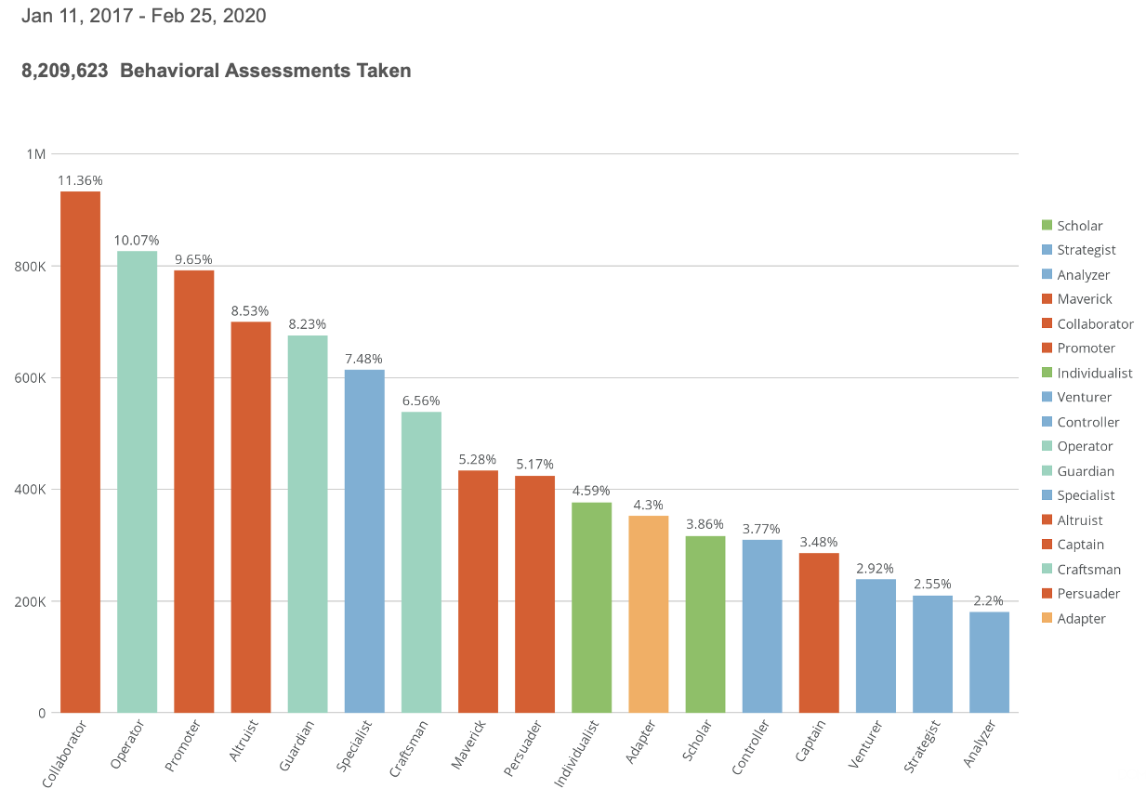
Jan 2017 - Feb 2020
8,209,623 Behavioral Assessments Taken
Jan 2017 - Feb 2020
8,209,623 Behavioral Assessments Taken

